Slide 1
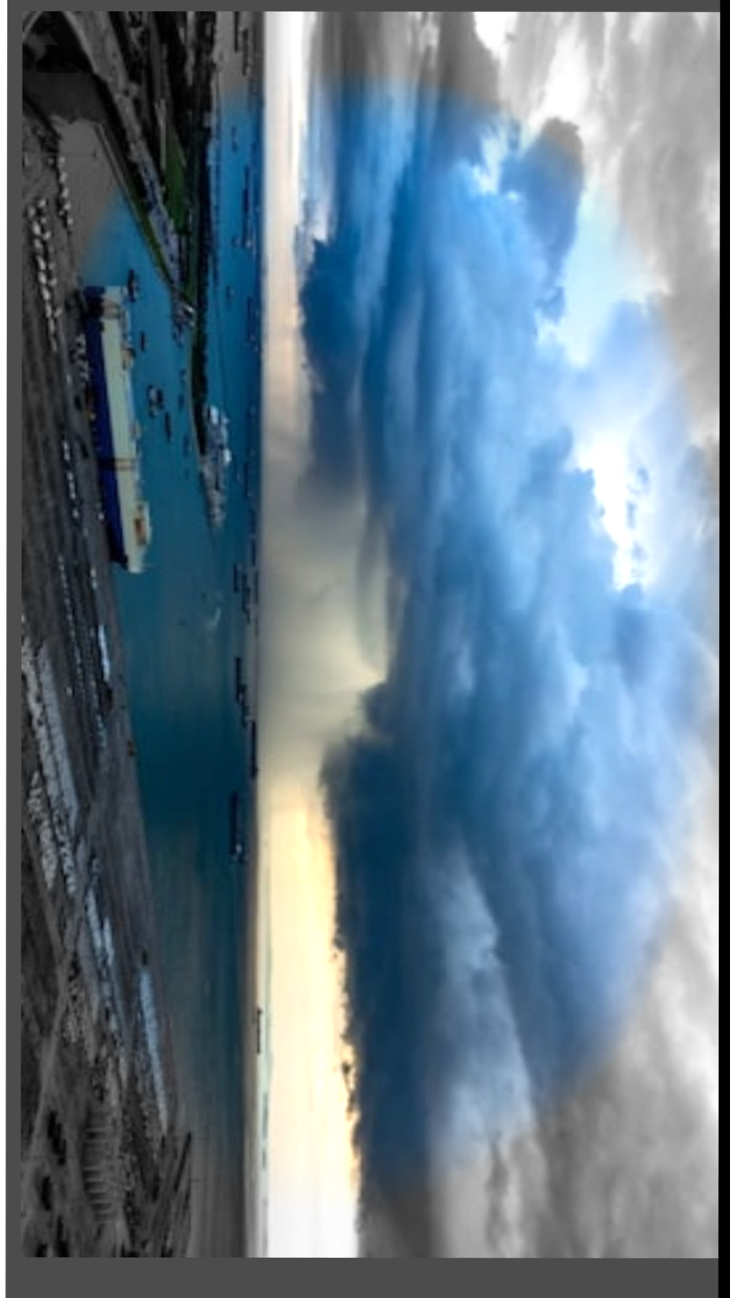
CLOUDBURST
PREDICTION
SYSTEM

Slide 2
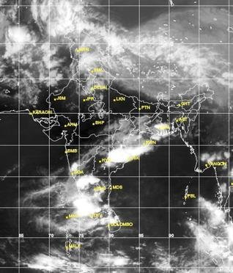
WHAT IS A CLOUDBURST?
A cloudburst is an extreme amount of precipitation in a short period of time,^{[1]} sometimes accompanied by hail and thunder, which is capable of creating flood conditions. Cloudbursts can quickly dump large amounts of water, e.g. 25 mm of the precipitation corresponds to 25,000 metric tons per square kilometre (1 inch corresponds to 72,300 short tons over one square mile). However, cloudbursts are infrequent as they occur only via orographic lift or occasionally when a warm air parcel mixes with cooler air, resulting in sudden condensation. At times, a large amount of runoff from higher elevations is mistakenly conflated with a cloudburst.
IMPACT:
Cloudbursts can be destructive on a large scale, especially in the mountains, causing floods, landslides, and mudflows that create terrible losses in the life and livelihood of the masses.According to statistical data,40% of the natural disasters account for floods in India.

Slide 3
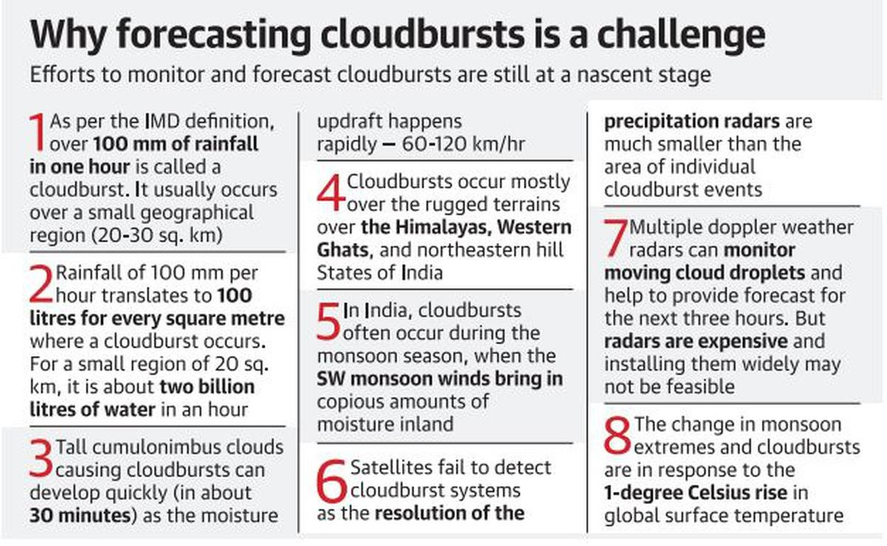
WHY IS OUR PROJECT INTIGUING?
We believe that our project is intriguing because of the direct implementation of our project and we have identified one full client (potential customer),ie,Uttarakhand Government.
As we can see the picture to our left,predicting cloudburst is a serious challenge. The government has tried various ways to tackle with this problem,some of which are:-
a)Construction of Dams and Reservoirs
b)Redirecting the excess water to canals and floodways
c)Excess water can be used for groundwater replenishment
Still a cloudburst has been a challenge even after so many pre cautionary measures.That’s where we want to bring the improvement and find a convenient solution to tacke with cloudburst prediction.

Slide 4
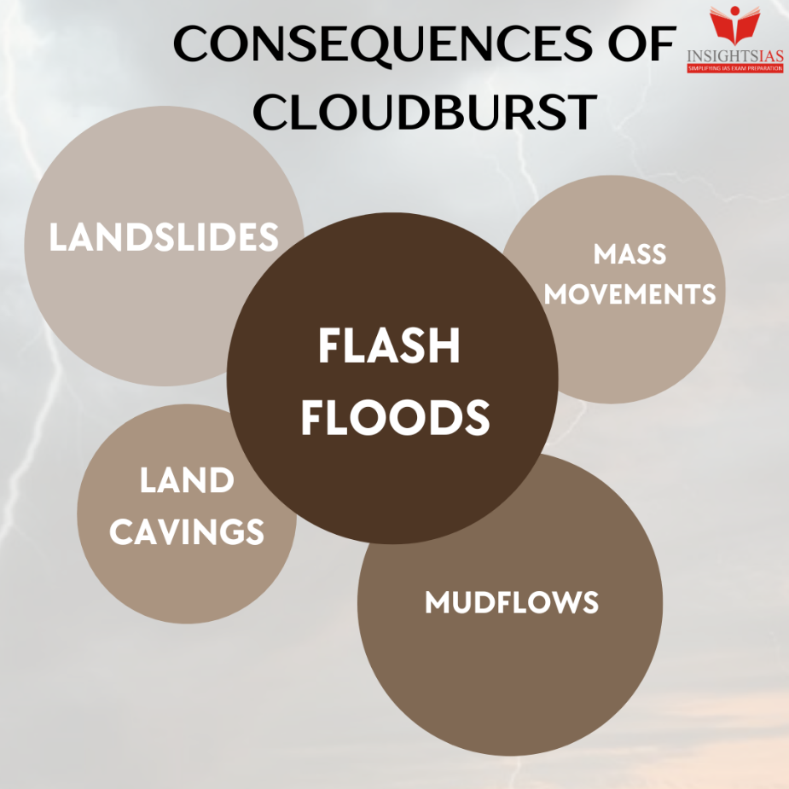
WHY WE CHOSE THIS PROBLEM STATEMENT?
We chose this problem statement because it is an immediate cause under the disaster management part,the solution to this problem will be hugely beneficial to the government organizations as well as the layman indirectly. Cloudbursts are known for their sudden and unpredictable nature, making their anticipation a formidable task. Traditional weather forecasting methods, while valuable for general weather predictions, often fall short in providing timely alerts for cloudbursts due to their rapid onset. To address this challenge, we employ a state-of-the-art Convolutional Neural Network-Long Short-Term Memory (CNN-LSTM) hybrid architecture. This innovative approach allows us to extract intricate temporal and spatial features from the time series data, enhancing our predictive capabilities. Ultimately, this work seeks to enhance early warning systems, improve disaster response strategies, and minimise the devastating impacts of cloudbursts in India and beyond.

Slide 5
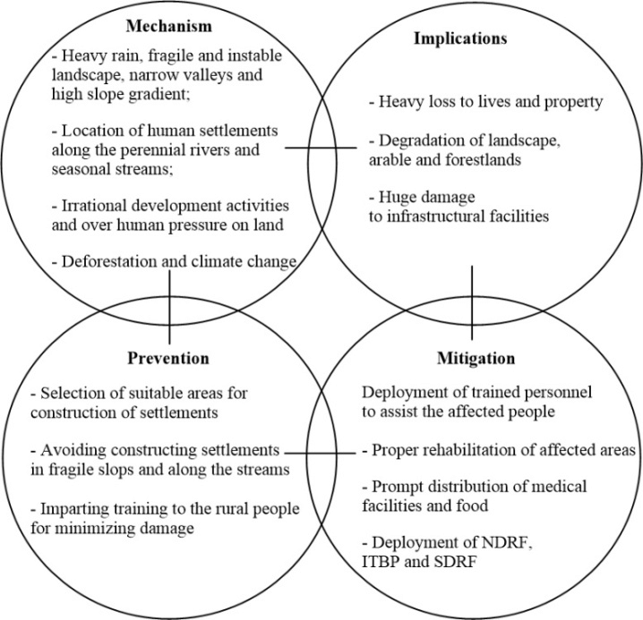
We are autonomous and this is AI powered model which will not require any extra manpower.

Slide 6
APPROACH TOWARDS OUR PROJECT
DATASET PROCUREMENT:- We procured the data from the official website of the Indian Meteorological Department, from where we gathered 15 weeks of weekly rainfall departures of 711 districts stretching from 1/6/2023 to 13/9/2023. The website link is given below :- https://mausam.imd.gov.in/imd_latest/contents/rainfall_statistics_2.php DATA PREPARATION AND PROCESSING:- For every district, we generated a time series vector containing the rainfall departures of 14 weeks. Using the 15th week’s rainfall departure, we mark whether there would be a cloudburst on the 15th week or not. If the departure on the 15th Week is >= 100 mm we mark it as a cloudburst. Thus we finally come up with a vector of 14 values and a label for every district.
After systematic analysis of the graphs presented, we identified that in case of cloudburst the leading edge of the graph is far beyond the 0 mark and has a steep rise in the rainfall distribution. These features are lacking in non-cloudburst marked districts.
DEEP LEARNING APPROACH:- We used a stacked CNN-LSTM Architecture to classify where the district would experience a cloudburst the following week or not. The CNN layers (specifically 1D Convolutions) extract relevant features from the time series data. The stacked LSTM was used to process the resulting time series which is further fed to a fully connected layer which classifies whether there would be a cloudburst or not. The architecture is discussed aside :

Slide 7
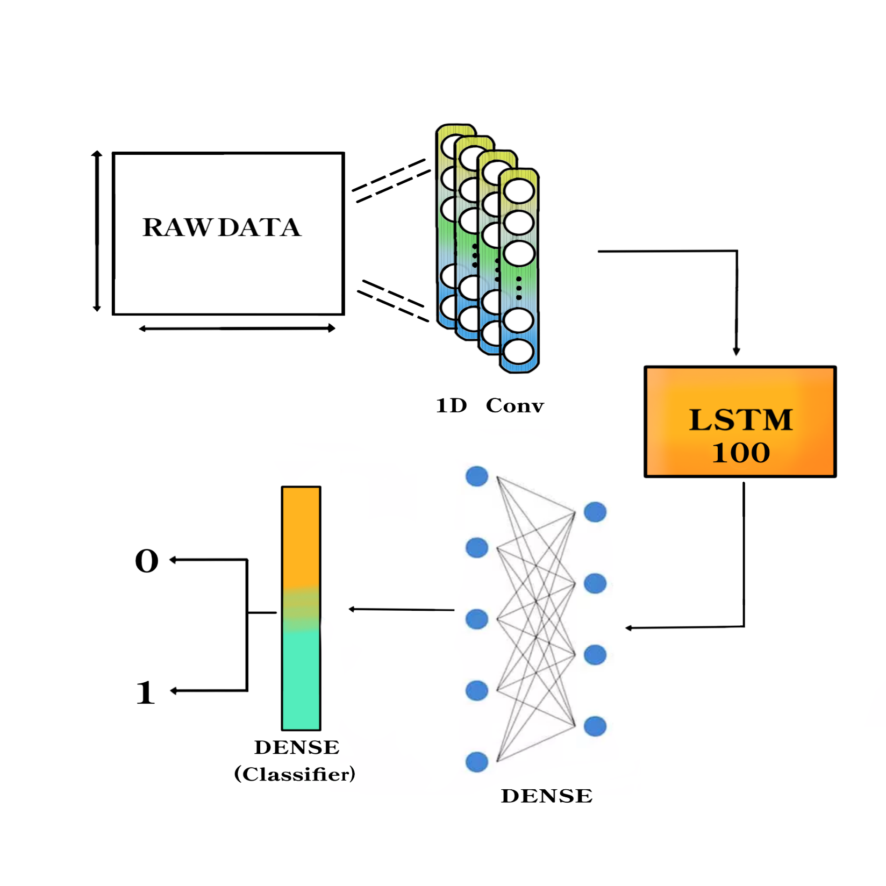
DEEP LEARNING APPROACH:

Slide 8
TARGET AUDIENCE:
Our essential target audience are the government organizations ,individual bodies and the layman indirectly.
TARGET BENEFICIARY:
Used by farmers to create awareness from beforehand regarding whether there will be a cloudburst or not ,i.e. a surge in rainfall so that they can take necessary precautions which will lead to an effective crop yield.
In the coastal regions, specially during the monsoons ,they can get aware whether there will be a cloudburst or not ,i.e. a sudden massive rainfall .This makes them cautious at least prior a week which ensures that their daily lives and jobs are unaffected.
It helps in the prediction of landslides , floods and other disasters in hilly regions which saves the live of many people and decreases the chances of severe destruction.
Aviation and Transportation Safety : Cloudburst forecasts help pilots and airlines make informed decisions about flight routes and schedules, reducing the risks associated with adverse weather conditions.
Tourism and outdoor activities

Slide 9
WHAT IS THE SUBSCRIPTION SYSTEM?
Our business interpretation is that we require the common men, government organizations or any individual working body to subscribe our software at a very nominal cost (we are not promoting free installation of our software) and in return we will provide our customers an efficient licensing of the software. Using these funds,we will try to improve and upgrade our project,buy more APIs and make our overall project better in many ways.Allso it is going to be a boost for us if a sufficient amount of people buys our software.
LIMITATIONS/SHOWSTOPPER:
Massive shortage of database :
Data scarcity is when a) there is limited amount or a complete lack of labeled training data, or b) lack of data for a given label compared to the other labels (a.k.a data imbalance).
We could procure only one set of data for every district for a duration of 15 weeks rather than multiple sets of data.Thus the database is highly dependent on government data.
CONTINUOUS IMPROVEMENT:
Remote Sensing and Monitoring:- Exploring satellite imagery and remote sensing data sources to monitor precipitation patterns and vegetation health.
SCALIBILITY AND ACCESSIBILTY:
For public usuability we have hosted it on a streamlit server. Our software can be used by all or any kind of local administrative body to predict a cloudburst in any district.

Slide 10
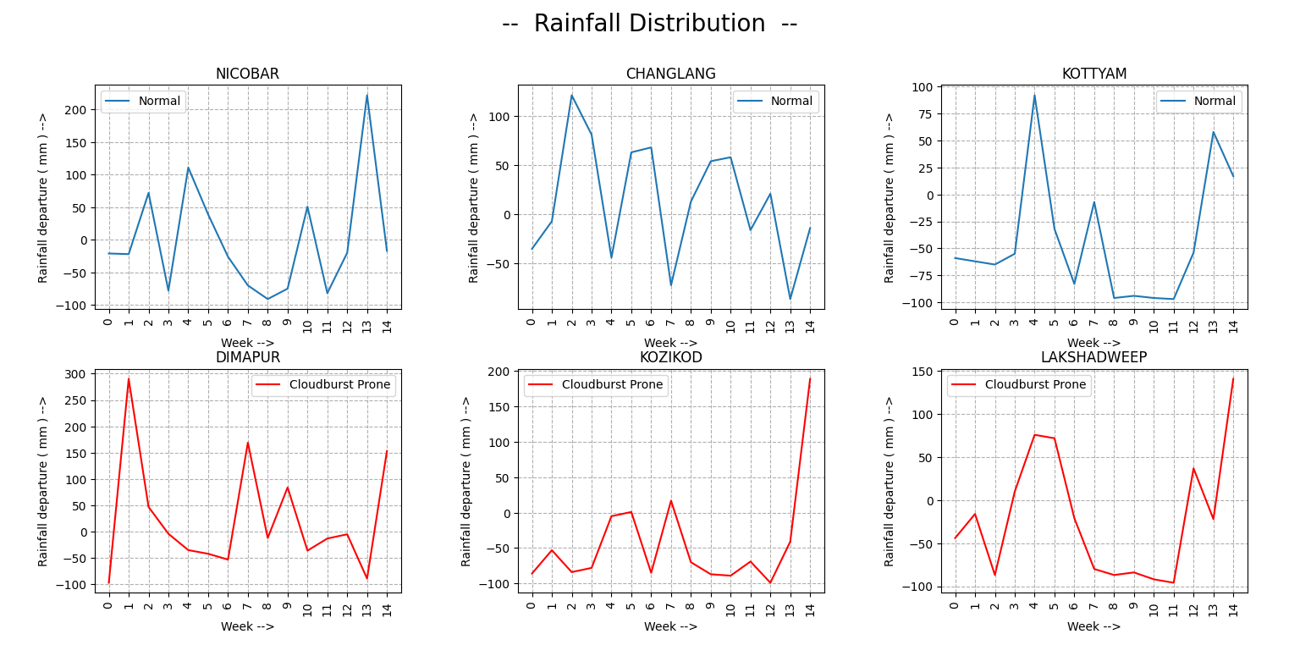
DATA ANALYSIS:

